Slide 1

395/495 Project Report
WGAN-gp Optimization
Jianping Zhang
Yuqi Chen

Slide 2

contents
01. Introduction
02. WGAN-gp
Introduction, application, analysis
Theory, improvement, code
03. Results
04. Conclusion
Mnist, Cifar. SGD, RMSprop, Adam
Conclusion, review and future work

Slide 3
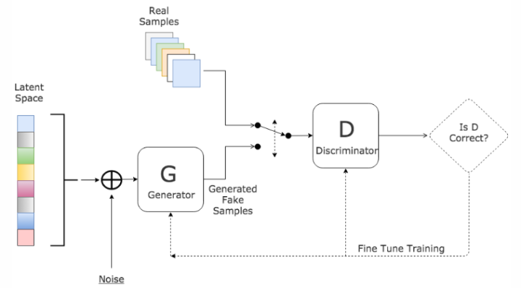
Introduction
Generative Model
Discriminator Model
Figure 1 Basic GAN Network

Slide 4
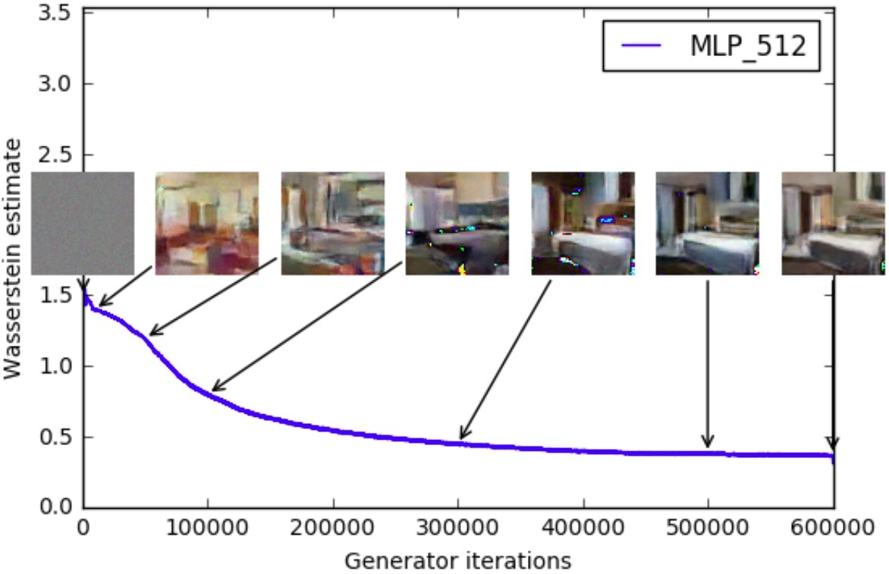
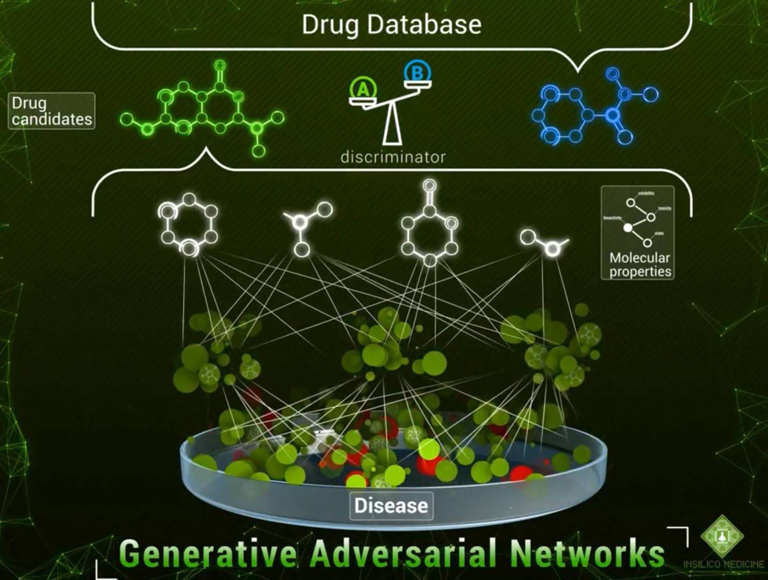
Application
Image generation
classification
Using GAN to generate images
Using GAN to match drugs

Slide 5
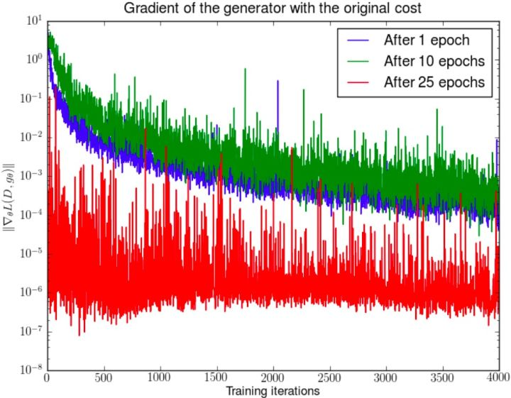
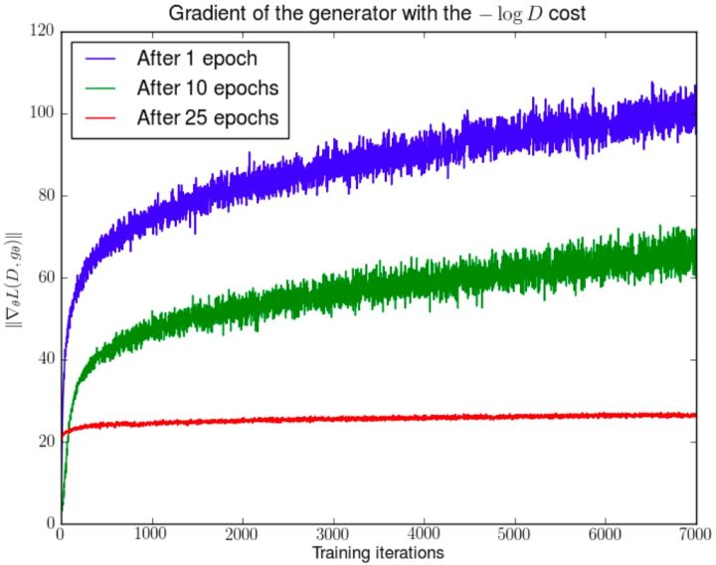
Disadvantages
training instability
failing to achieve convergence
With the training of the discriminator, the
gradient of the generator is rapidly attenuated
The gradient of the generator grows rapidly,
indicating that the gradient is unstable.

Slide 6
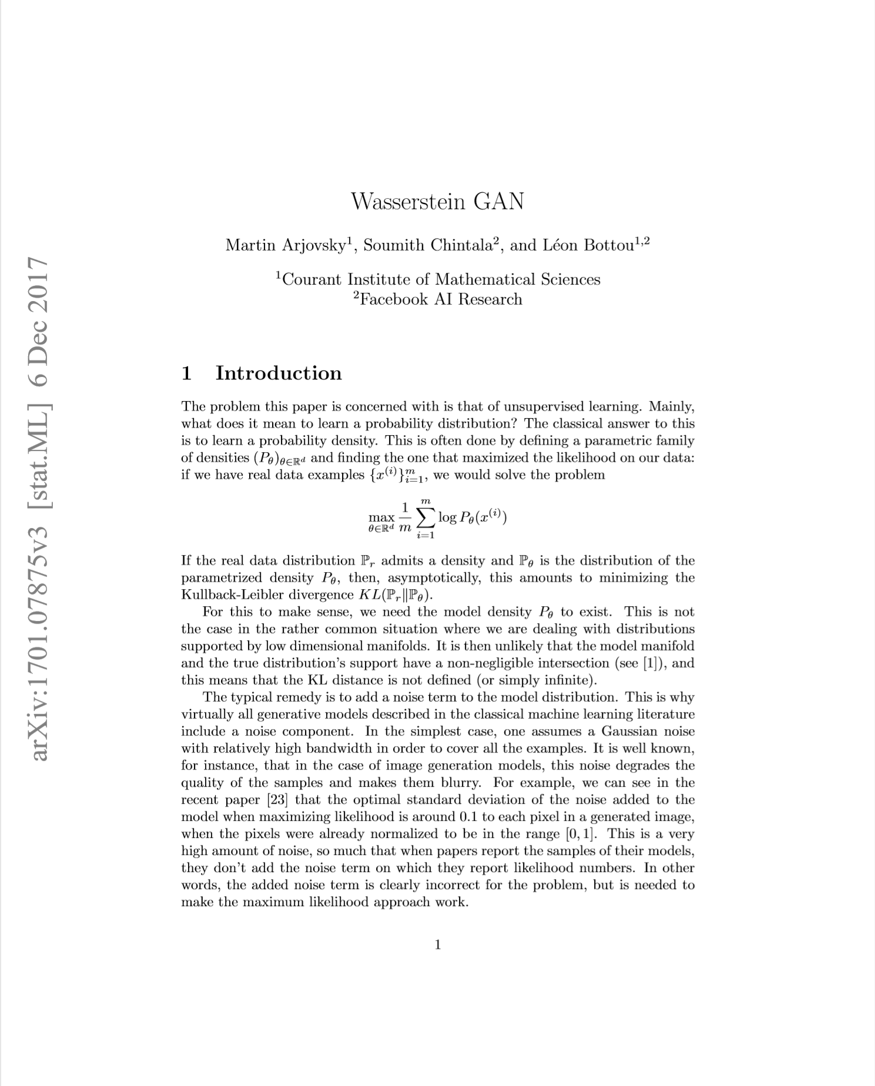
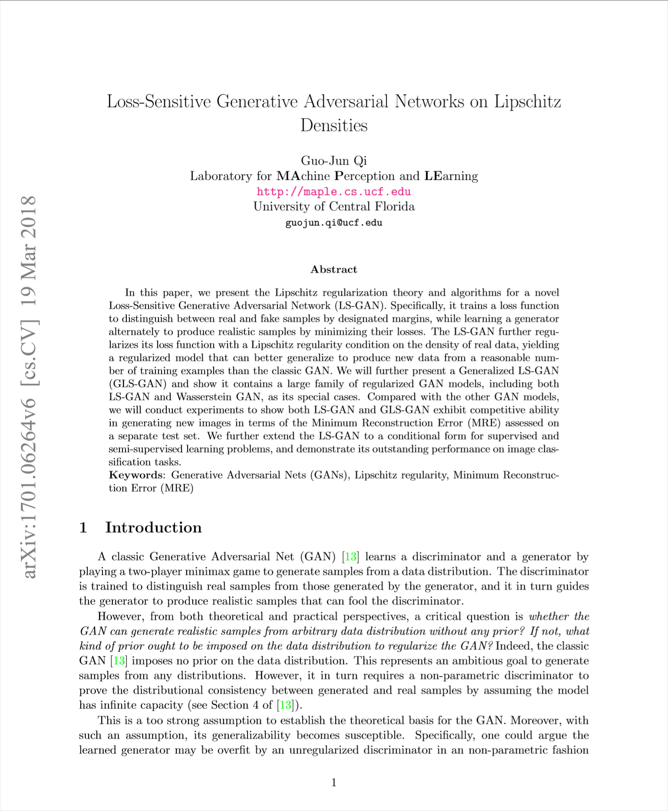
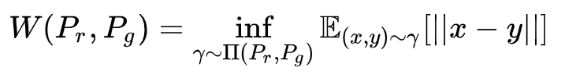
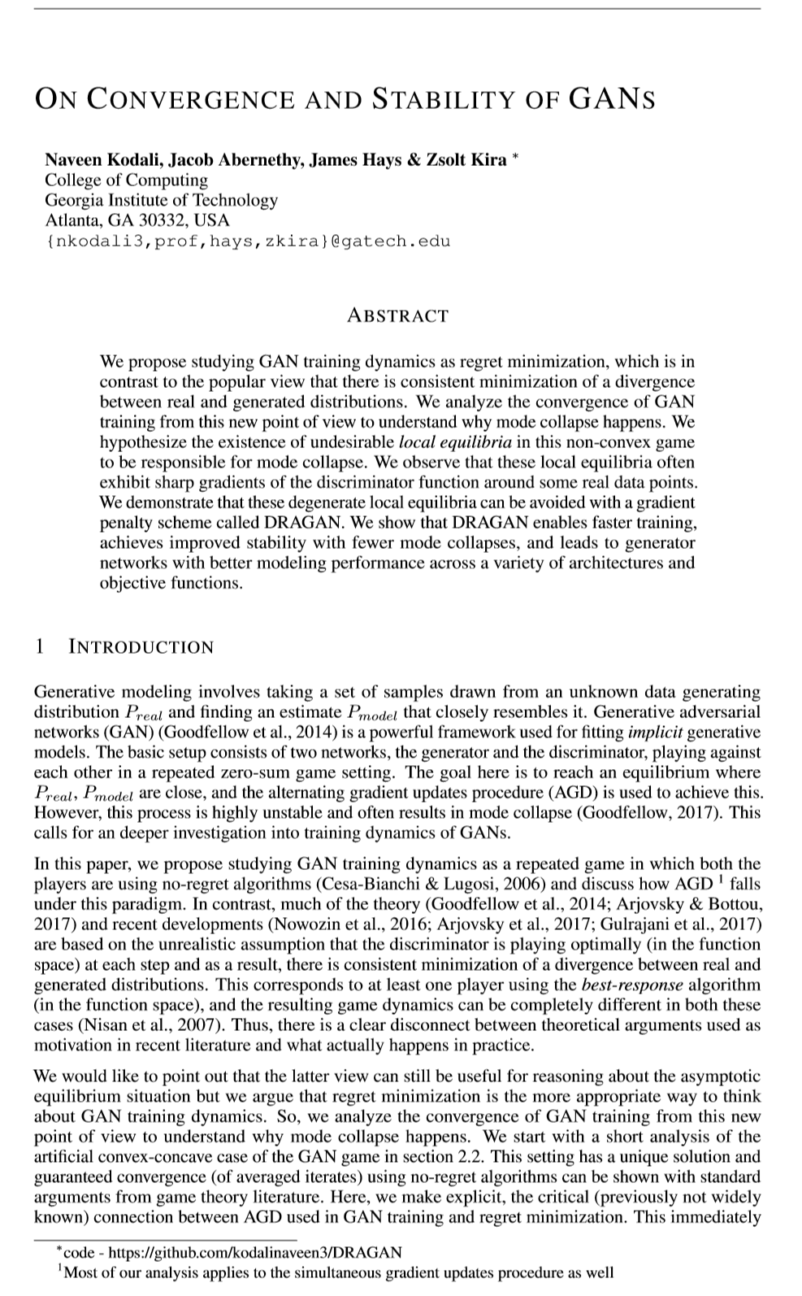
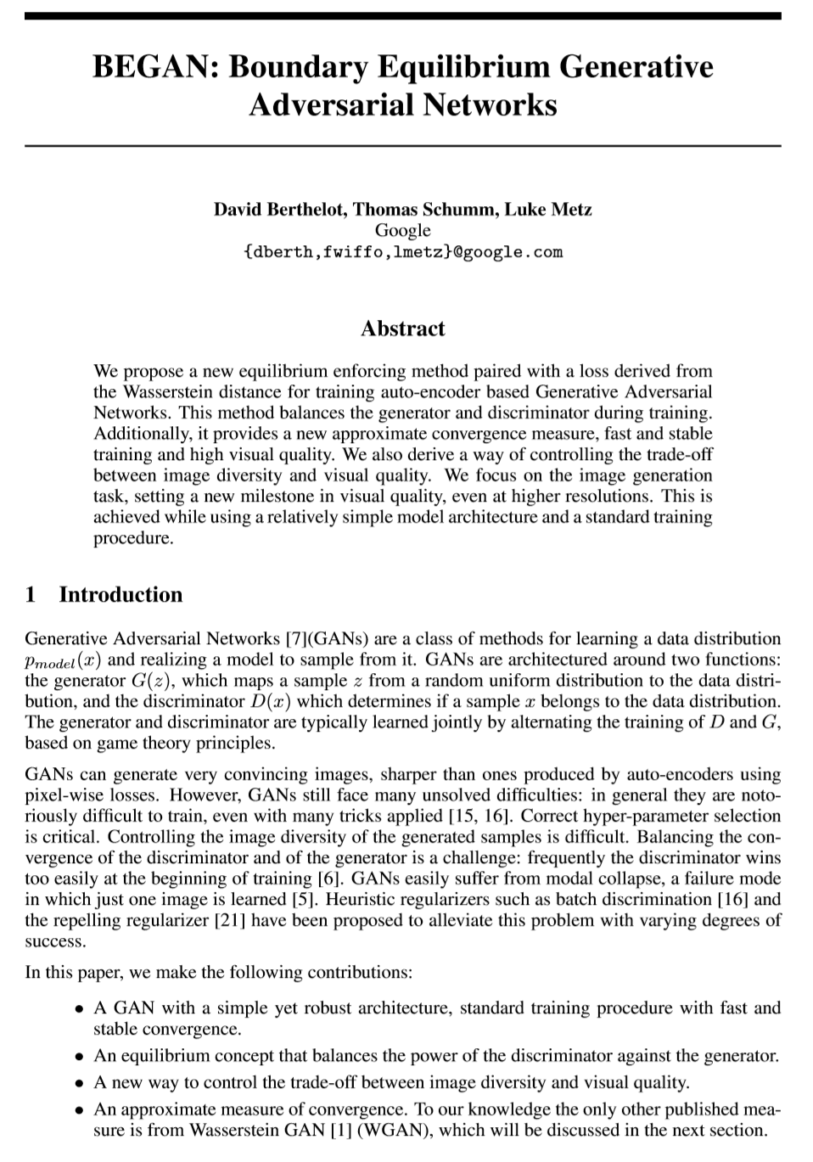
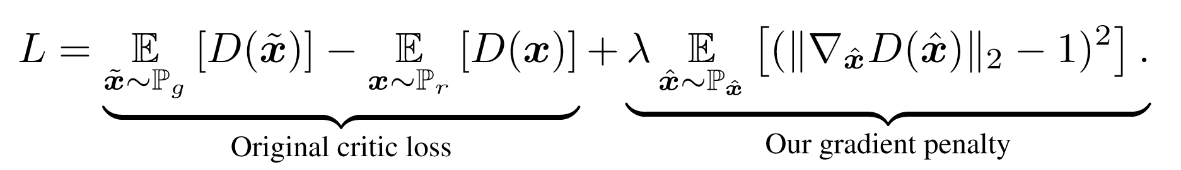
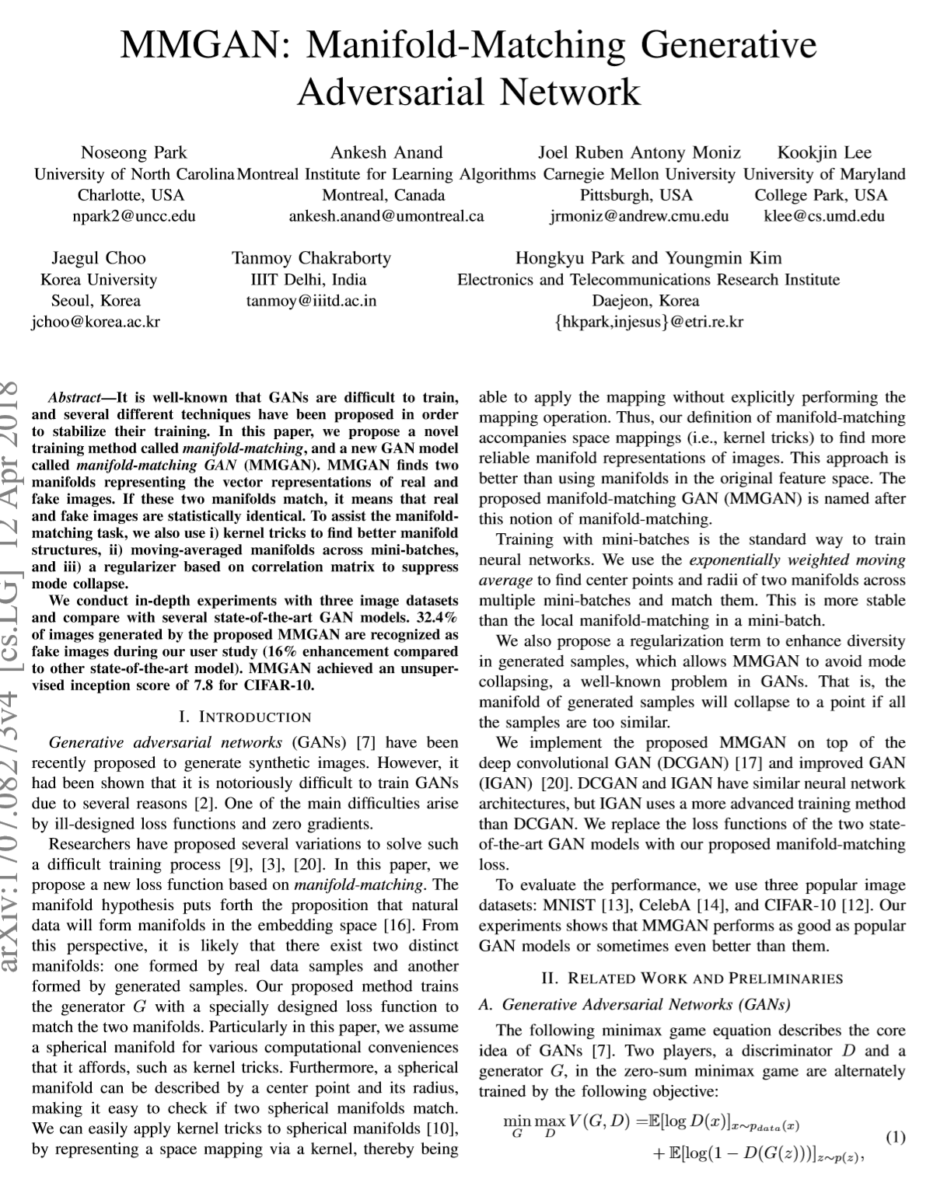
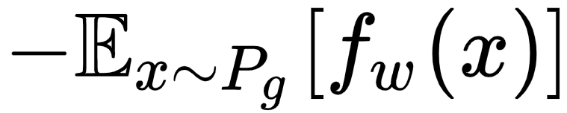
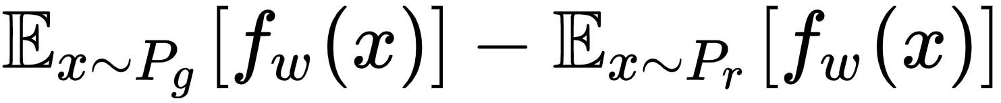
Optimization Strategy:
Wasserstein Distance(Earth-Mover Distance):
MM GAN
NS GAN
WGAN
LS GAN
DRAGAN
BEGAN
……
Wasserstein Distance with gradient penalty:
WGAN-gp
Generator’s loss function:
Discriminator’s loss function:

Slide 7
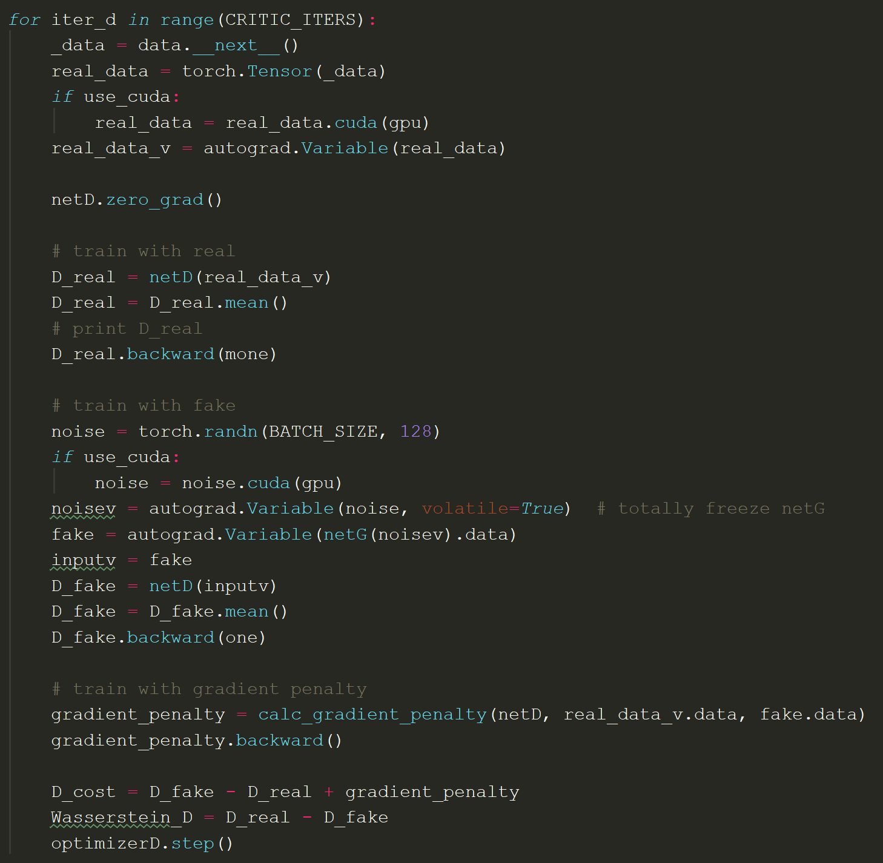
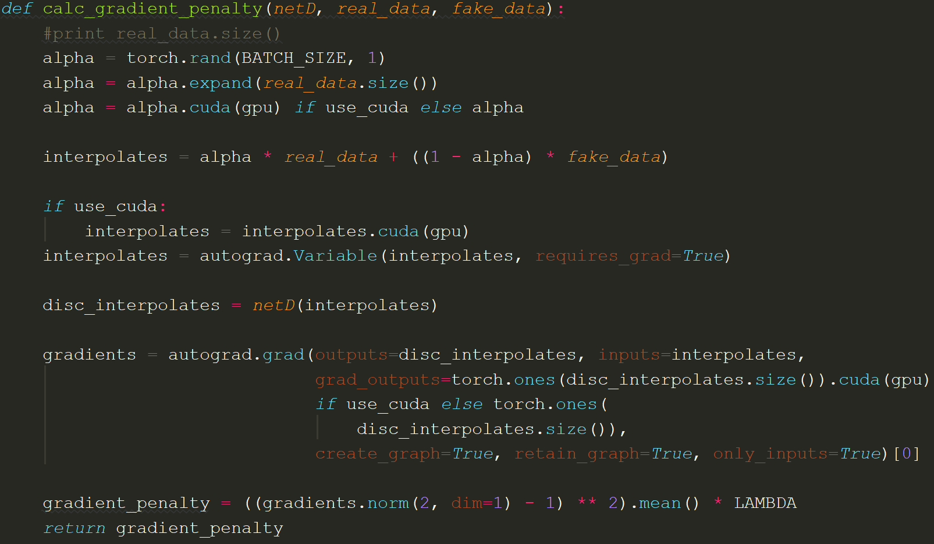
Code Implementation：

Slide 8
Our
objective
1. Verifying the superior features of WGAN-gp;
2. Comparing several different optimization strategies learned from classes in this term

Slide 9
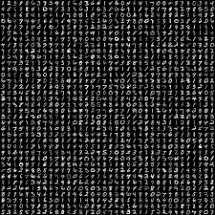
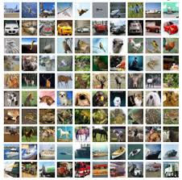
Datasets:
Mnist dataset
Cifar10 dataset

Slide 10
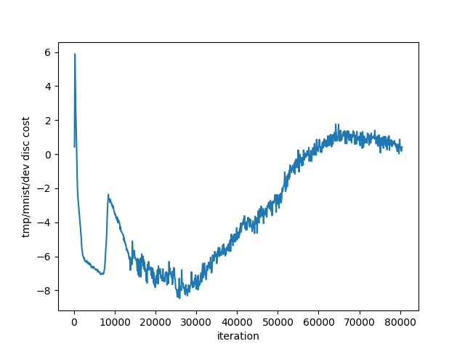
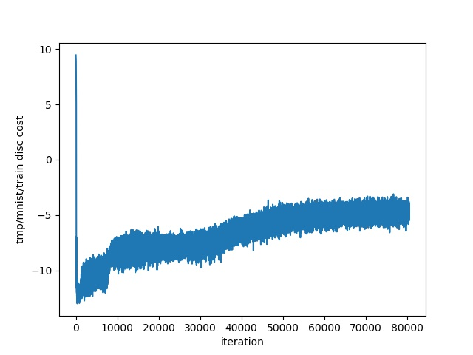
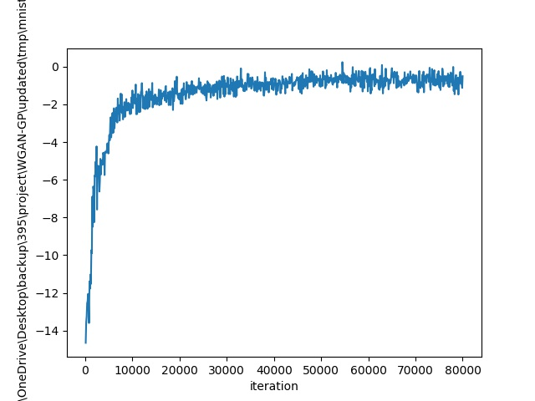
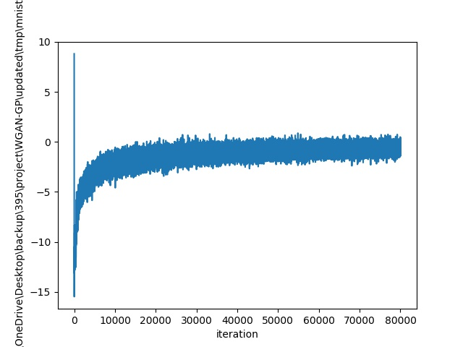
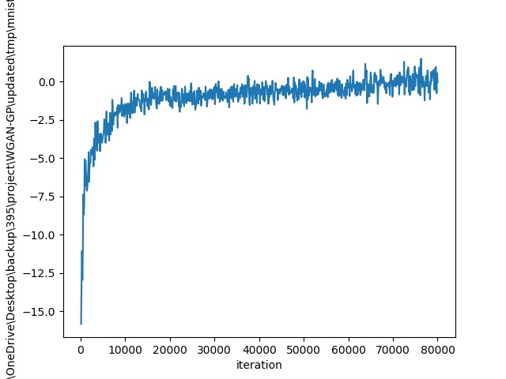
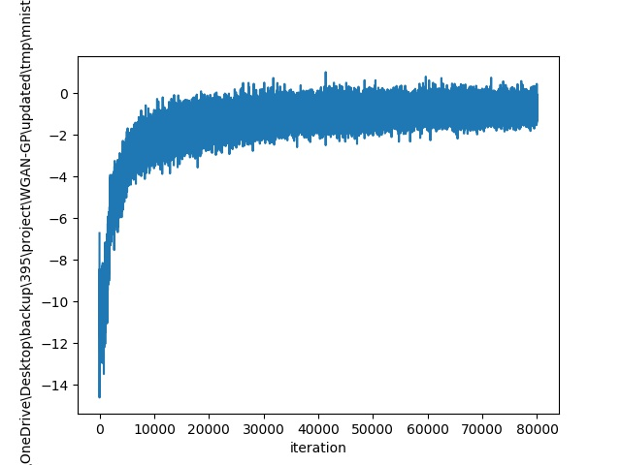
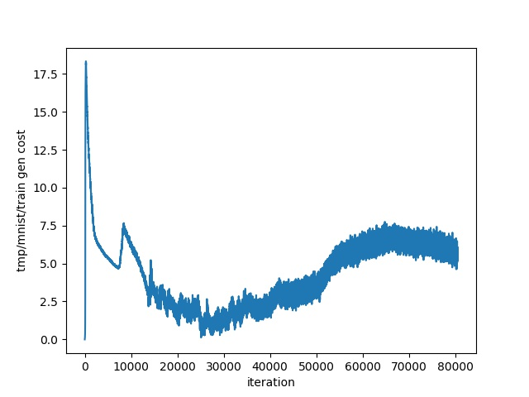
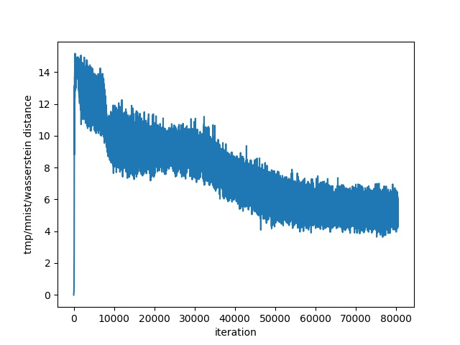
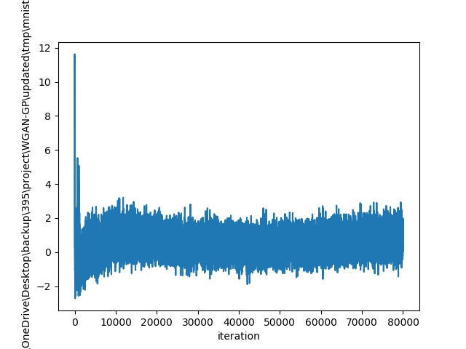
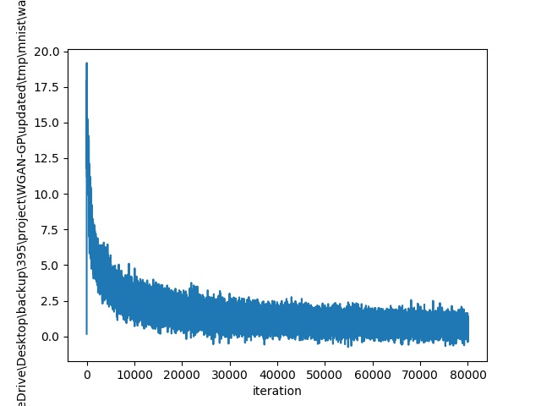
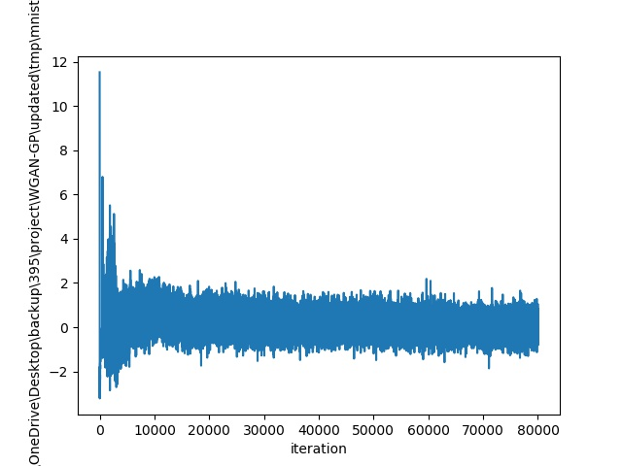
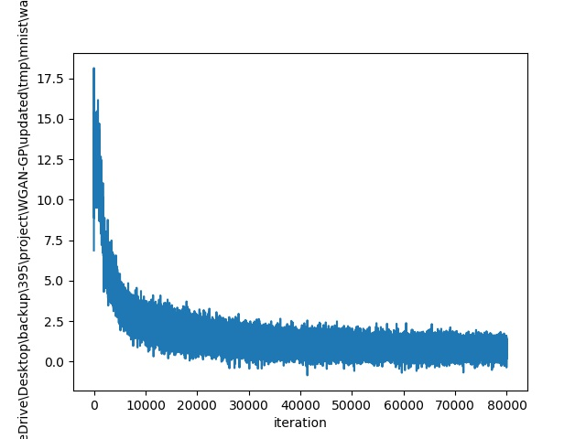
SGD：
RMSprop：
Adam：
Mnist
dataset
Figure 1.
Discriminator’s loss function on dev dataset
Figure 2.
Discriminator’s loss function on train dataset
Figure 3.
Generator’s loss function on train dataset
Figure 4.
Wasserstein distance on train dataset

Slide 11
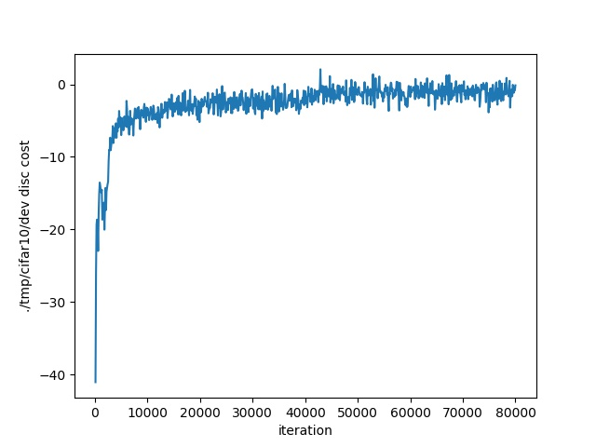
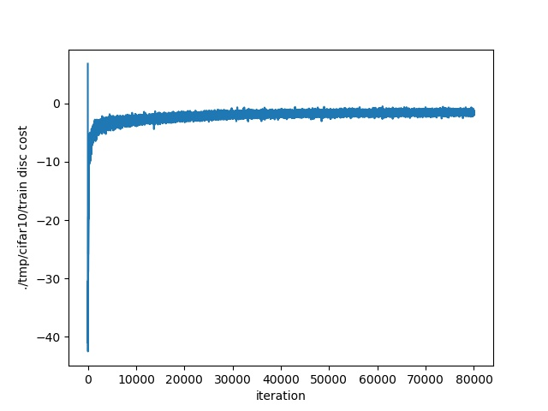
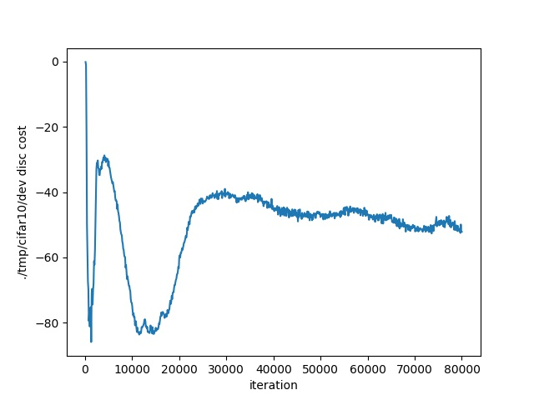
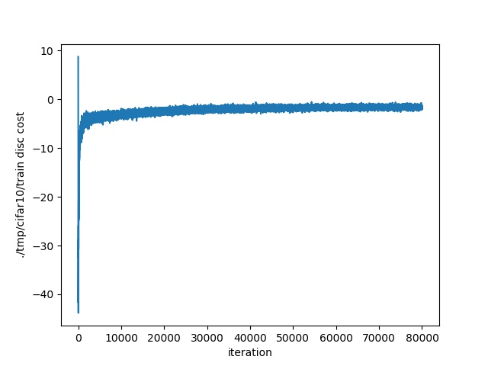
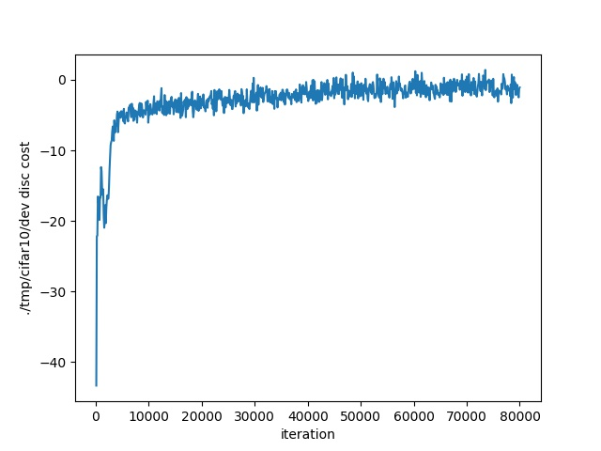
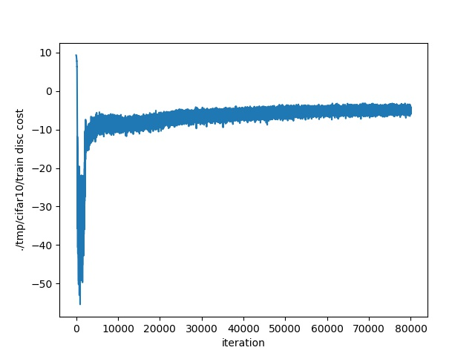
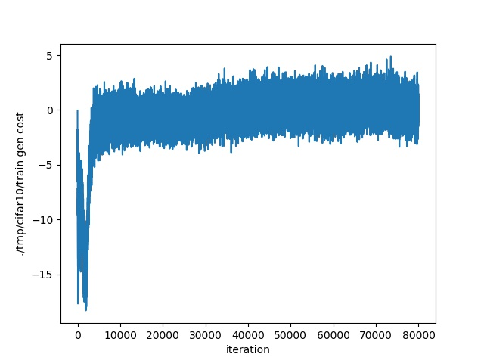
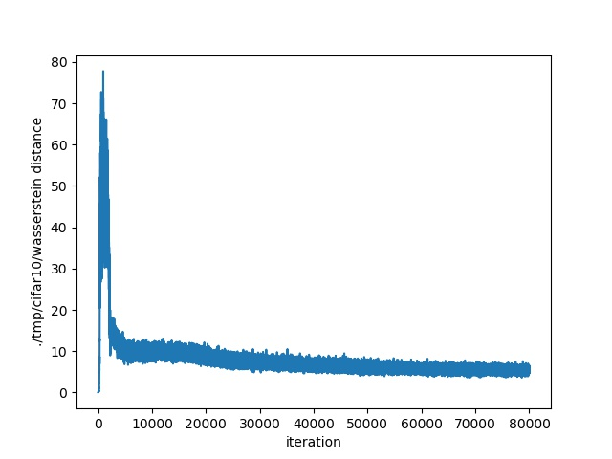
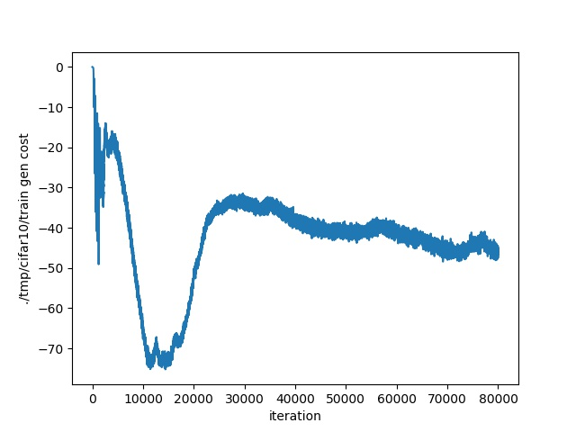
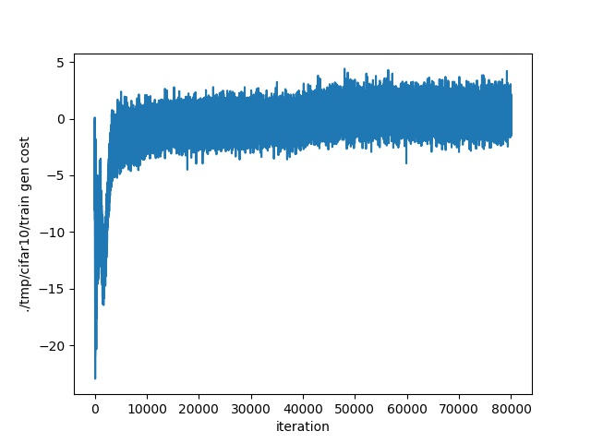
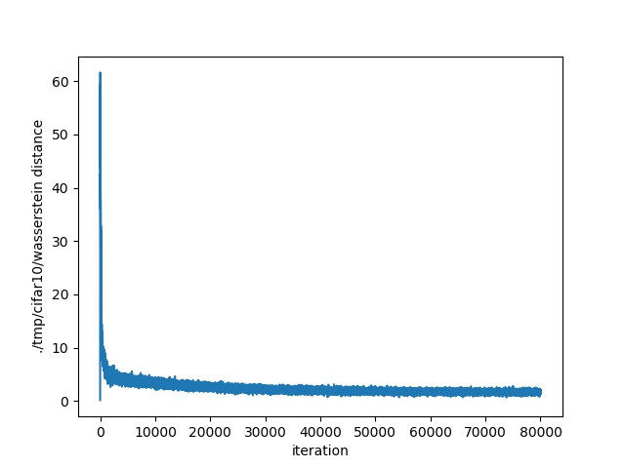
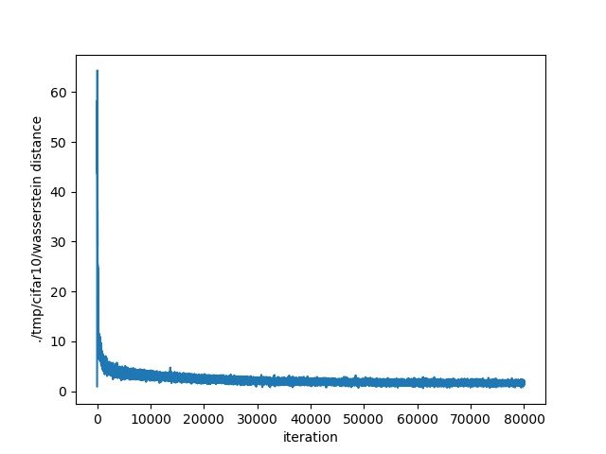
RMSprop：
Adam：
SGD：
Cifar10
dataset
Figure 1.
Discriminator’s loss function on dev dataset
Figure 2.
Discriminator’s loss function on train dataset
Figure 3.
Generator’s loss function on train dataset
Figure 4.
Wasserstein distance on train dataset

Slide 12
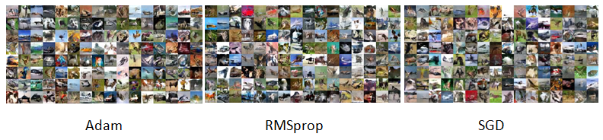
Generated Images

Slide 13
Conclusion
Training process
Optimization methods
The whole training process shows:
The training process is stable with all optimizers
The WGAN-gp model could generate images that is similar to the real pictures with no mode collapse problem
Conclusions about the optimizers:
all of the optimizers work
RMSprop algorithm is the best choice for training WGAN-gp model

Slide 14
Review
Review
Completing all of our objectives;
Handling the process of building neural network;
Being familiar with deep learning packages;
Comparing the performance of different optimizers on real project.
and
Future work
Future work
Trying other optimizers and comparing their performance;
Implementing experiments on more datasets in real world.

Slide 15
Thank you！

